Slide 1

Home Weather Control System
Team 46
Kushagra Agrawal – 2024101110
Devshree Vyas – 2024111003
Samarth Rao - 2024111035

Slide 2
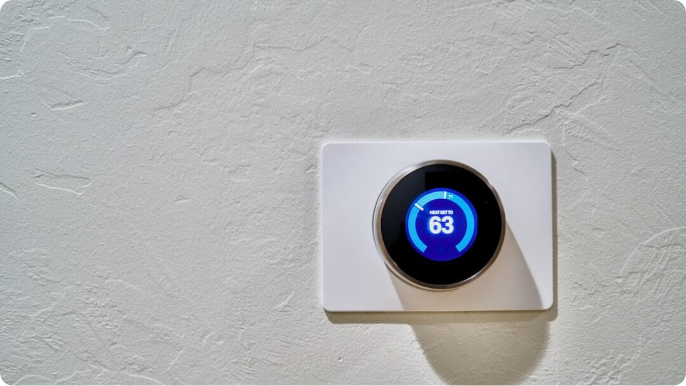
Challenges Solved by Smart Climate Control
Enhanced Comfort: System adjusts indoor climate in real-time based on occupancy, temperature and humidity conditions as well as CO₂ levels in the room.
Remote Control: Users can control temperature remotely via our website – kushagra1310.github.io/IIOT_Project
Environmental Impact: Reduces unnecessary power consumption and carbon emissions, contributing to eco-friendly living.
Replace with our own photo
Notes:
Let’s look at the problems our Smart Home Climate Control project aims to solve. First, energy efficiency: HVAC systems are among the top consumers of home electricity. By automating control using real-time data and schedules, the system can cut energy usage by up to 30%. Second, enhanced comfort—imagine your room staying at the perfect temperature all night without manual adjustments. Third, the power of remote monitoring: you can warm your house before you even arrive. Lastly, the environmental benefit: smarter energy use leads to lower emissions and a greener footprint. These are real, impactful improvements.

Slide 3
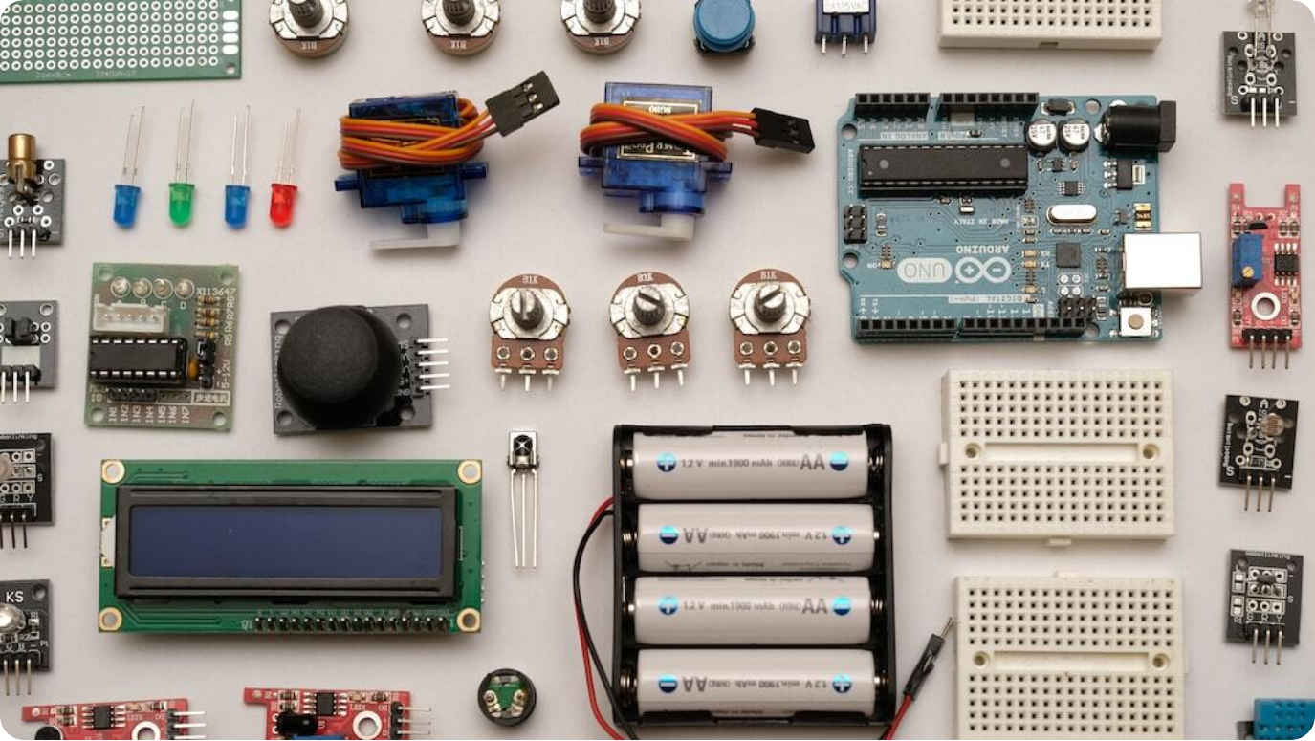
System Architecture Overview
End-to-End Smart Climate Control Flow
Sensors as Input: DHT22 (temperature/humidity), Ultrasonic, Infrared, MQ135 for real-time environment data.
ESP32 Microcontroller: Chosen for its usability with Wi-Fi; and handles logic and controls outputs.
Actuators as Output: Representational AC (with LEDs), fan, automatic window—triggered based on sensor data and rules.
MQTT Protocol: Efficient, lightweight communication across IoT devices; ensures low latency.
Replace this with our photo
Notes:
This slide gives an overview of the architecture that powers our smart climate control system. Inputs come from various sensors: DHT22 for temperature and humidity, ultrasonic and infrared for occupancy, and MQ135 for air quality. The core brain is the ESP32 microcontroller, known for robust performance and built-in Wi-Fi—perfect for our needs. Outputs include actuators like fans, windows, and AC units that adjust the indoor environment. All communication happens through the MQTT protocol, a reliable and low-overhead system that connects sensors to controllers and the web dashboard.

Slide 4
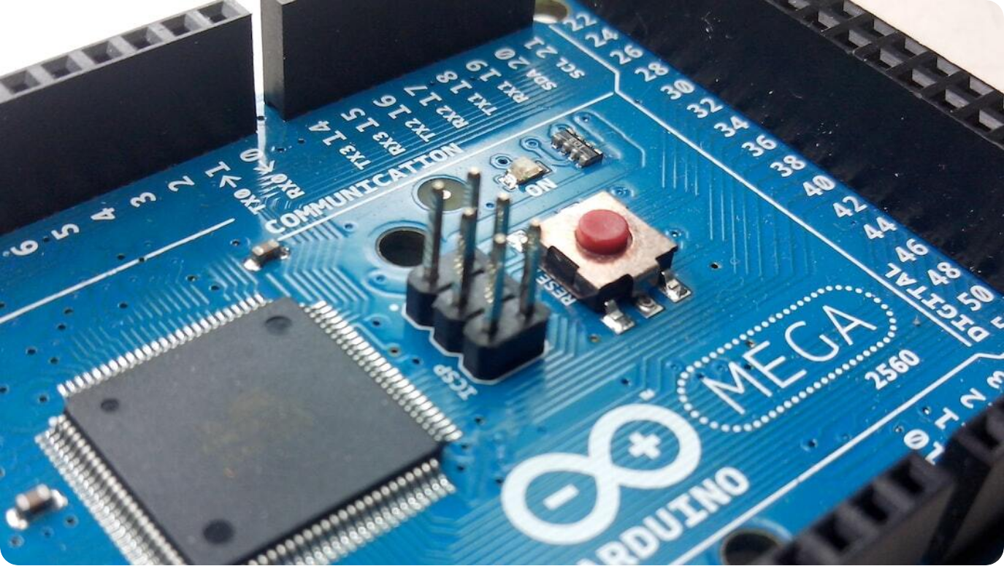
Software Stack
Tools Powering the Smart Home System
Arduino IDE: Primary development environment for ESP32 microcontroller coding in C/C++.
Python: Used for backend processing and MQTT message handling on the server side.
Mosquitto Broker: Manages communication between sensors, the dashboard and the actuators
Web Dashboard: HTML/CSS interface for real-time climate control and monitoring.
Photo by Felipe Faria on Unsplash
Notes:
The software backbone of our system is built on accessible yet powerful platforms. We use the Arduino IDE for programming our ESP32, as it's lightweight and well-supported. On the backend, Python scripts manage the server logic and handle MQTT communication. At the heart of our messaging system lies the Mosquitto broker—a widely used MQTT platform that's ideal for small and scalable IoT setups. To top it off, we've designed a responsive web dashboard using HTML, CSS, and JavaScript that allows users to monitor and adjust their home climate in real-time.

Slide 5




Code Logic
Placeholder for Implementation Details
Sensor Reading Loop
Continuously reads data from DHT22, MQ135, and the ‘people sensor’ (ultrasound + infrared)
Threshold Evaluation
Compares real-time values to pre-set thresholds to trigger actions.
MQTT Messaging
Publishes sensor data to the broker and listens for actuator commands.
Control Logic
Based on logic tree, actuates fan/AC/window via GPIO if conditions are met.
Notes:
This slide is reserved for a deeper dive into the code logic of our smart climate control system. It follows a loop structure where sensor data is read and evaluated against thresholds. If a condition is met—for example, high temperature—it triggers appropriate actions via the actuators. All sensor data and commands are handled over MQTT to maintain a lightweight and responsive communication loop. You can later add screenshots or snippets of your core functions here.

Slide 6
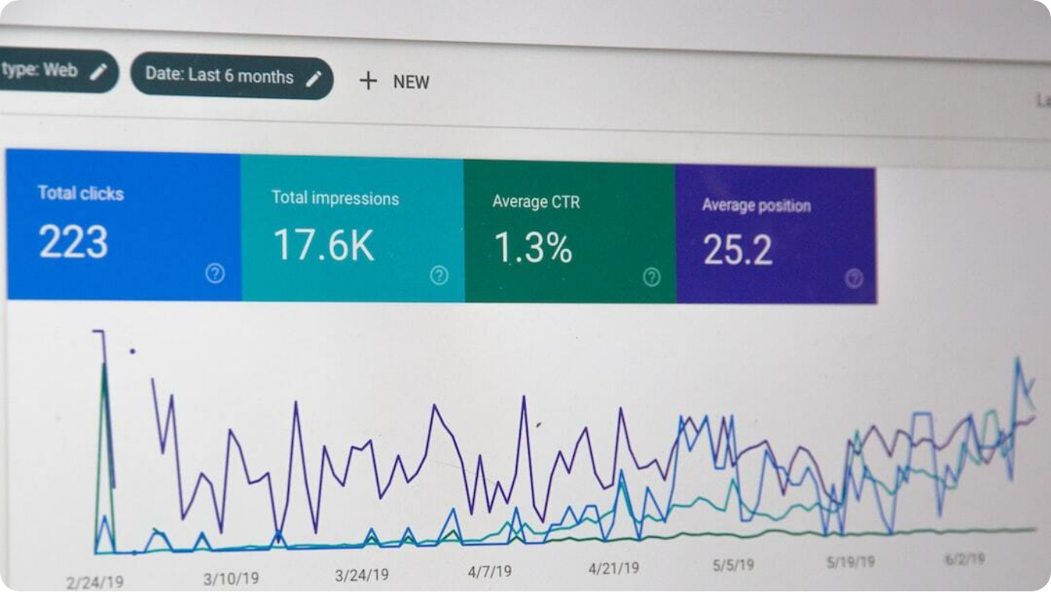
Results & Observations
System Performance and Insights
Data Trends: Captured real-time sensor values of temperature and humidity, revealing consistent climate control.
Power Efficiency: Estimated 25% energy savings by reducing HVAC operation during idle or optimal conditions.
Response Time: System responded within 1–2 seconds to sensor triggers—ideal for real-time automation.
Test Environment: Prototypes tested in a controlled home setup with successful pre-cooling and auto-off routines.
Photo by Stephen Phillips - Hostreviews.co.uk on Unsplash
Notes:
We evaluated our system using actual sensor deployments and recorded temperature and humidity data over time. The data showed the system's ability to maintain a stable indoor climate. On the energy front, the system achieved an estimated 25% reduction in power use by minimizing unnecessary HVAC operations. The response latency was minimal—within 1 to 2 seconds after sensor detection, which is sufficient for smooth real-time actuation. These tests were conducted in a mock apartment setup to simulate real-world conditions and routines like pre-cooling worked flawlessly.

Slide 7
Challenges Faced
Placeholder for Team Reflections
Connectivity Issues: Placeholder - Describe problems faced in maintaining stable MQTT/Wi-Fi communication.
Sensor Calibration: Placeholder - Discuss any inaccuracies in sensor output and how they were addressed.
Power Management: Placeholder - Note any limitations related to power consumption or efficiency.
Debugging Complex Logic: Placeholder - Challenges in handling simultaneous inputs and ensuring smooth outputs.
Photo by Dan LeFebvre on Unsplash
Notes:
This slide serves as a placeholder for reflecting on the technical and logistical hurdles faced during the project. You can elaborate on real issues like dropped MQTT connections, inconsistent sensor readings, and challenges in debugging the code logic when handling multiple sensor inputs. Addressing these would show your problem-solving approach and readiness for future improvements.

Slide 8
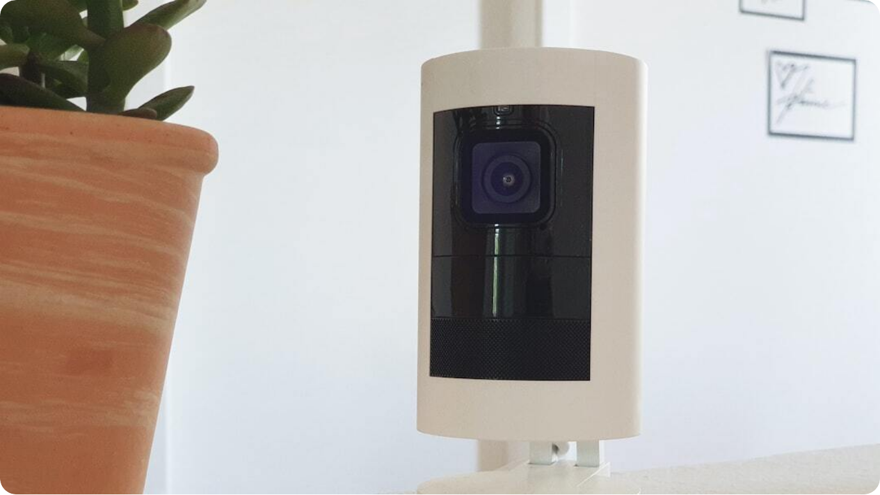
Future Work & Improvements
Enhancing Capabilities & Scalability
Machine Learning Integration: Train models using usage patterns to optimize control strategies and predict behavior of the user
Voice Assistant Compatibility: Enable Alexa and Siri compatibility
Renewable Power Supply: Integrate solar panels, to further decrease power consumption
Multi-Room Expansion: Scale system to monitor and manage climate in homes which have multiple rooms
Photo by Sebastian Scholz (Nuki) on Unsplash
Notes:
Looking forward, there are several exciting areas to expand the scope of our system. First, integrating machine learning would enable the system to analyze usage data and automatically adapt settings to user behavior. We also aim to support voice control through Google Assistant or Alexa, making it even more user-friendly. Another key area is sustainability—by powering the system with solar energy, we can greatly reduce its environmental impact. Finally, we plan to expand it to support multiple rooms, ensuring full-house smart climate management.

Slide 9




Conclusion
Project Impact and Learnings
Efficiency Gains
Lorem epsum lar David ul sangat or honge Lorem epsum lar David ul sangat or honge Lorem epsum lar David ul sangat or honge
User-Centric Design
Remote access, automation, and integration ensure a highly comfortable and convenient user experience.
Environmental Responsibility
Supports eco-friendly living by optimizing energy use and reducing emissions.
Technical Insights
Hands-on experience with IoT architecture, MQTT, sensor networks, and real-time system design.
Notes:
In conclusion, our Smart Home Climate Control project delivers meaningful benefits across convenience, efficiency, and sustainability. By leveraging smart sensors, microcontrollers, and MQTT communication, the system provides precise, automated control that enhances comfort while saving energy. The project also allowed us to apply key IoT concepts in practice—from real-time sensor handling to frontend-dashboard integration. This initiative not only solves real-world problems but also strengthens our technical foundations for future innovations.

